Slide 1
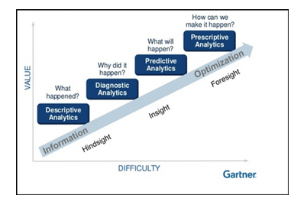
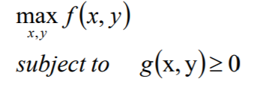
Optimisation(covering Mathematical Optimization, Mathematical Programming, Operations Research)

Slide 2
References
https://www.informs.org/Explore/Operations-Research-Analytics
Look into
Applied optimisation
Supply chain optimisation
Using graph theory
Using machine learning

Slide 3
Advice
Try to write algebraically
Create dummy data in excel and use excel solver
Then try to translate to your python package, again using just dummy data and handful of accounts to trace what is happening

Slide 4
Optimisation in the widest possible sense
Various different types of optimization algorithms
The choice of which algorithm to use depends on
the specific problem being solved
the properties of the objective function, decision variables and constraints
The available computational resources
Includes: gradient-based algorithms (i.e. where have differentiable functions e.g. gradient descent)/ evolutionary algorithms / dynamic programming / linear programming etc.
Optimisation algorithms specific to Data Science include: Gradient Descent / ADAM / Adagrad / Bayesian Optimisation / Simulated annealing / Nelder-Mead (for non-differentiable
Used to find weights in NN or parameters in model that min the loss function

Slide 5
Fields where optimisation algorithms are applied
Operational Research
- Optimal decision variables for business decision
Finance
- e.g. portfolio management
Engineering
- To help design structures etc.
ML algorithms
- Model optimisation i.e. finding parameters that min loss function / hyperparameter tuning / reinforcement learning
Marketing
- optimise campaigns and performance

Slide 6
Potential courses
Course | Thoughts | Rank | Completed?
https://www.youtube.com/watch?v=dbZJky2RbnE https://www.youtube.com/watch?v=KxMUE8igQ5I
https://developers.google.com/optimization/introduction/overview
https://www.coursera.org/learn/wharton-operations-analytics#syllabus | Bit simple but good primer esp. for applications. Can probs rattle through videos | 1 | Yes
https://www.coursera.org/learn/solving-algorithms-discrete-optimization#reviews | Relies on minizinc | 1
https://www.coursera.org/learn/advanced-modeling#syllabus | Might be quite complex – maybe later
https://www.coursera.org/learn/business-analytics-decision-making#syllabus | Pick + choose which to do. Has solver algorithm | 0 | Yes
https://www.coursera.org/learn/simulation-models-for-decision-making?specialization=analytics-for-decision-making#syllabus
https://www.coursera.org/learn/advanced-models-for-decision-making#syllabus | Looks potentially useful but applications maybe not suitable
https://www.coursera.org/learn/optimization-for-decision-making#syllabus | Looks very good!!

Slide 7
Optimisation Use Cases
Pretty much all business problem tbh
Optimisation at Amazon
Optimal location for warehouse construction to meet demands of an area
Optimal supplier for certain products
Optimal products to procure based on forecast demand
Optimal storage of products
Scheduling optimisation
E.G. EPG scheduling to maximise total viewing across the day for a specific channel (based on type of viewer, shortlist of shows, and competitor shows on other channels, how can we max viewing)
Optimisation at groceries
Market basket analysis – find the optimal layout that maximises lift ratio i.e. cross selling activities. You establish rules to max cross-selling opps. So if x purchased then so is y. If lift=2, means that if item X bought then twice as likely to buy item y. Store wants to optimise placement of products to maximise the total lift ratio of products near each other
How many call agents to recruit for each shift
Need to forecast call demands
Mininimise call wait time s.t. n_employees & cost
GPS
Optimises route for us
Max conversion rate s.t. marketing budget and channel constraints
Price optimisation
Vehicle routing: Find optimal routes for vehicle fleets that pick up and deliver packages given constraints (e.g., "this truck can't hold more than 20,000 pounds" or "all deliveries must be made within a two-hour window").
Scheduling: Find the optimal schedule for a complex set of tasks, some of which need to be performed before others, on a fixed set of machines, or other resources.

Slide 8
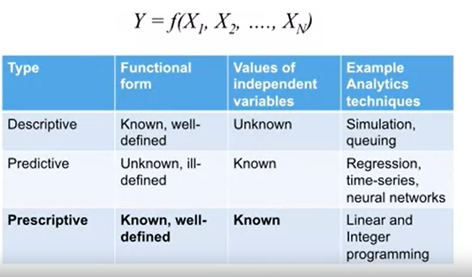
Optimisation Fundamentals
Optimisation consists of three components: minimize f(x), w.r.t x, subject to a ≤ x ≤ b
Objective function → f(x)
Decision Variables → x_{1,}x₂
Constraints → a < x < b
Involves traversing a search space (which contains all feasible solutions as defined by any constraints) to find the decision variables/parameters that minimises/maximises some function. We track and record the objective function at each stage and update our expectations/search method according to our chosen algorithm
Optimisation = branch of prescriptive analytics
because recommends what to do e.g. where to build factories in logistics OR how to build a portfolio that manages risk
See table - decision variables known + functional form known
optimal values for the decision variables (X_{1,} X₂ etc.) that min/max our objective function value is unknown, hence need for optimisation
N.B. Functional form may only be known because we have already used a predictive technique in a prior step
But often involves use of all four types of analytics
descriptive/diagnostic/predictive/prescriptive

Slide 9
Difficulties in handling optimisation problems
Tricky to convert to algebraic equation which can lend itself to optimisation
i.e. expressing your problem in terms of a mathematical optimisation model
If a constraint is that you cannot use competitor companies then company_{a} + company_{b} <= 1
i.e. need to be imaginative when turning your problem into mathematical formulation
Is one thing to verbalise the inequalities/constraints but far harder to translate into code to be used by your optimisation library of choice
Might be able to translate it into code but is taking too long
So need to be creative and find alternative way to code out the problem
Problem type may not be linear or convex which can make it very difficult to solve or find a global min
NP says few problems he has worked on are convex or can be proven to be convex, so often uses non-convex approaches
often In which case, advise using heuristic or metaheuristic approach (e.g. genetic algorithms)
These cleverly sample and traverse the search space to find an approx. solution, avoiding the need to formally define constraints
May need to make assumptions about functions (e.g. revenue function is concave) to ensure analytically tractable

Slide 10
Dictionary
Term | Definition
Operational Research | Largely involves algorithms to solve combinatorial optimisation problems
Solvers | Optimisation algorithms but usually refers to the software E.G. Excel solver, OR-Tools 9.3 Solver CPLEX/Simplex/Branch&Bound Might use the same solver but a different framework i.e. both OR-Tools and PuLP may both use MPSolver - Determines how we traverse the search space + adjust search according to learnings E.G. Simplex algorithm (for linear optimisation, finds optimal solution by traversing the vertices of the feasible region until there is no more improvement in the objective function)
Search type : Local search vs global search

Slide 11
Soft constraints
Conditions that can be broken if no feasible solutions
Hard constraints
Conditions that must be met

Slide 12
Sometimes optimisation isn’t actually about finding the optimal (i.e. best) solution
Solution Type | Description | Approaches that have this aim (doesn’t guarantee this will be the solution type!)
Optimal Solution | one for which the value of the objective function is the best. ("Best" can be either a maximum or a minimum.) | LP MIP
Feasible Solution | one that satisfies all the given constraints for the problem, without necessarily being optimal | Constraint Programming

Slide 13
How to choose which type of algorithm to solve the problem? (geared more towards Operational Research optimisation problems)
Approaches
Linear programming
Integer programming
Heuristics
Constraint Programming (CP aka Constraint Optimisation)
Metaheuristics (e.g. Evolutionary algorithms)
Simulation & Monte Carlo Simulations
Criterion for which to use?
Discrete or continuous decision variables?
Can objective and constraints be expressed linearly (similarly, is it smooth)
Size of problem (how many decision variables) and respective compute complexity
Is objective function convex or non-convex
Is objective function differentiable OR non-differentiable

Slide 14
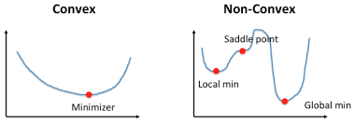
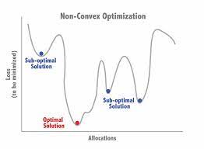
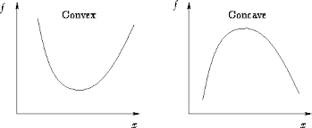
Convex vs Non-convex Optimisation
In few real-world problems can convexity be guaranteed, thus often non-convex approaches used
Convex optimization (convex landscape)
One global optimal solution (or even prove no feasible solution)
Solved quickly + reliably up to v.large size (‘000s of variables/constraints)
Most traditional problems in ML / statistics are convex e.g. linear regression / kernel methods / linear programming
Non-convex optimization (non convex landscape)
Multiple locally optimal points (in high dimensions, possibly even infinite)
Can take a lot of time to identify whether the problem has no solution or if the solution is global.
Nowadays most problems are non-convex with the use of DL/DNN (their cost functions are non-convex)
Identifying Convex vs Concave Functions?
Convex function = second order derivative of f(x) is >= 0 (or hessian matrix i.e. matrix of second partial derivatives is positively defined) e.g. quadratic or exponential function
Concave function = second order derivative of f(x) is <= 0
unless your objective and constraints were linear, it is difficult to determine whether or not they were convex.

Slide 15
Evolutionary Algorithms (EAs)
Inspired by natural selection + genetic mechanisms
A generic population-based metaheuristic optimization algorithm
heuristic-based approach to solving problems that otherwise cannot easily be solved in polynomial time e.g. NP-Hard problems
i.e. means do not find an optimal solution but quasi-optimal
Examples
Genetic algorithms
Differential evolution

Slide 16
Genetic Function Example (PyGAD)
Define n offers such that it minimises the difference from their current offer + minimises the impact on churn
Objective function can be either
Min offer distance
Min churn impact
Using pyGAD (genetic algorithms) at the moment
Genetic algorithms remove the need for formally define constraints etc algebraically and instead cleverly traverse the search space. Uses a strategy a bit like random search except learns from previous parameter attempts whilst not limiting scope too much so don’t get caught in local minima/maxima
Method
Has a list of all the offers to BT Sports customers
Finds the unique offers given [0,4,8,10]
Specifies that we want just 2 offers in our final solution
For each unique offer, calculates the nearest offer and distance from it – then multiplies this by number of customers with this offer e.g. total_distance_moved_array = [4*1000, 4*500, 2*2000, 2*100]
Solution could be [0,0,1,1], [1,1,0,0],[0,1,1,0] etc. and would multiply by our array
Solution_total = total_distance_moved_array * [0,1,0,1] ← this is our fitness function
Aim of GA is to find the one that

Slide 17
Combinatorial Optimisation problems
A type of mathematical optimisation problem
Example
Price elasticity decision
Characteristics
Involve (often huge) discrete search spaces i.e. often even too big & expensive for computers
Finding an optimal solution from a finite set (the set of feasible solutions is discrete or can be reduced to a discrete set) that satisfies all constraints
Most belong to NP-hard problems esp. as no. parameters (aka size of problem) increases
To find optimal solution involves exhaustive search which may be computationally infeasible esp where large problem size
Space can be too larger to find an exact solution (too large to exhaustively search using brute force)
Thus need for quasi-optimal solutions
Operational Research largely involves algorithms for solving these types of problems
Possible approaches to solve?
Integer programming (ILP) e.g. Branch and Bound techniques (i.e. divide and conquer style approach)
However often exact algorithms are infeasible, and heuristic/metaheuristic algorithms (using random search) must be employed to find exact solutions or at least good quality solutions E.G.
Random-restart hill-climbing
Simulated annealing
Genetic algorithms
Tabu search
Constraint programming

Slide 18
Graphs & Optimisation
Nodes & vertices

Slide 19
Which framework to use
No matter which you choose, it should be equivalent when written algebraically on paper
Will just need to translate it into the framework syntax so it can then feed it to the solver engine

Slide 20
Framework | Pros | Cons
PuLP | Very Easy & intuitive API No need to mathematically modify problem or use vectors and matrices. Everything is cleaner and less prone to errors | - Limited to just LP and MIP problems
ORTools | Wide range of optimisation algorithms (LP/MIP/CP etc.) that can flexibly be changed without need to rewrite code from scratch i.e. robust & flexible framework that allows you to use same code but just plug in different solvers under a single API Particularly powerful for large scale optimisation problems i.e. combinatorial optimisation problems – uses state of art algorithms to narrow search set Finds optimal or approx. optimal solutions Flexible - can build custom solvers or integrate with existing solvers e.g. PuLP Various solvers incl. CP + LP + MIP + GraphAlgorithms | - Steep learning curve - Difficult to convert algebraic problem into code and quite limited documentation
Moptipy | - Metaheuristic optimisation methods, that can be adapted to almost any optimisation problem | - These methods are a little more black box
MiniZinc | - Constraint programming provided | - Need to download MiniZinc distribution and IDE i.e. cannot use in python so steepest learning curve as need to learn high level languaeg
PyGAD | - Evolutionary algorithms (EAs), specifically genetic algorithms
Scipy | Suite of optimisation algorithms e.g. scalar optimisation (of a single convex variable); Local & Global Search; Least Squares; Curve Fitting (i.e. mins difference between points to produce a best fit line); Linear programming solutions | Most of these are used as building blocks in other algorithms rather than for OR-style optimisation problems
Pyomo
NetworkX

Slide 21
Optimisation Steps (at least for LP)
Decision/optimisation problems have 3 key components
Objective function
- Profit / revenue
Decision variables
The prescription recommended to your company i.e. how many units to supply/ what offers to give
The solver/optimiser will find these values that min/max some objective value
Constraints
Used to define/restrict your feasible search space
Physical constraints = only n boxes can fit in a truck
Managerial constraints = only 10% of costs can be fixed
N.B. The objective function & constraint functions are expressed in terms of the decision variable
Steps
Define the variables
Define the constraints
Define the objective
And specify if min OR max problem
Accordingly choose your solver/algorithm
Will have a class of algorithms to choose from but worth saying that no single LP algorithm or solver is best
Specify a time limit OR number of iterations
Find (approx.) optimal solution
Example that uses this flow: https://developers.google.com/optimization/lp/lp_example

Slide 22
Simulations vs Monte Carlo – what is the difference ?
Simulations | Monte Carlo
Simulations of a model that is inherently random i.e. randomness exists already in the problem E.G. A dice throw | Uses random numbers to solve a model that is deterministic We introduce randomness to get a deterministic solution E.G. The expected revenue (£) – there is only one possible outcome, but we randomly sample variables as inputs into the model to approx. an answer

Slide 23
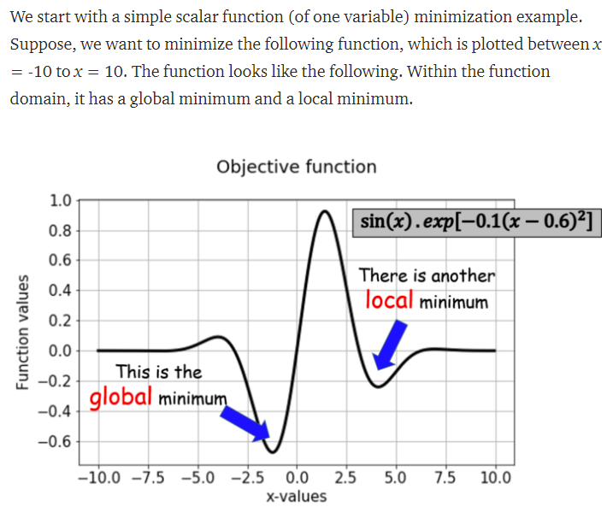
Example of Scipy’s scalar (univariate) optimisation
# To find the global minimum (unconstrained/unbounded optimisation i.e. no restrictions) #
from scipy import optimize result = optimize.minimize_scalar(scalar1)
print(result)
>> fun: -0.6743051024666711
nfev: 15
nit: 10
success: True
x: -1.2214484245210282
# In real world, often have complex constraints to factor in:
result = optimize.minimize_scalar(scalar1, bounds = (0,10),method='Bounded’)
Print(result[‘x’] )
>> When bounded between 0 and 10, minimum occurs at: 4.101466164987216

Slide 24
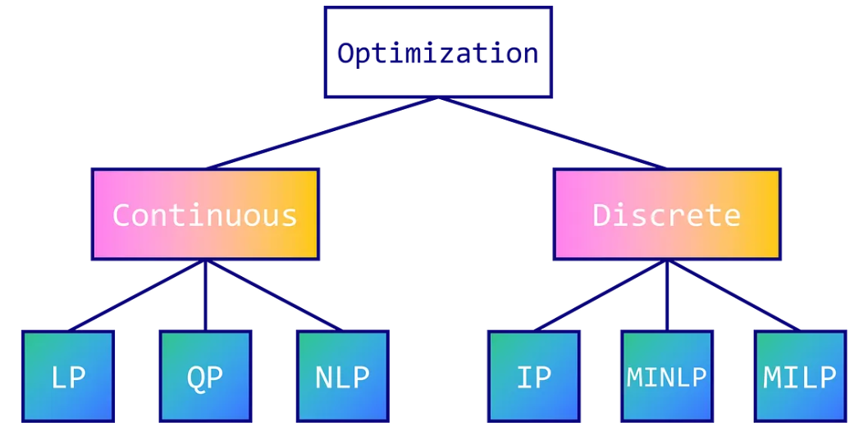
The solver (optimisation engine) used depends on the type of optimisation problem (are variables continuous or discrete)
N.B. Programming is a misnomer here. Just refers to planning
Type | Explanation | Solution Type
Linear Programming (LP) | Continuous values e.g. 0.666 possible Decision variable must be non-negative Can solve quickly/efficiently even with larger number of decision variables & constraints (so always best to try to express as linear problem) All functions in the model can be expressed linearly including constraints (i.e. graphically represented as a straight line. A quadratic would not be for instance x²) whereas cost=x+y, profit=(P*Q)-costs are both linear E.G. GLOP Solver If your problem can be modelled with a linear objective and linear constraints, then you have a linear programming problem and should consider sth like MPSolver
(Linear) Integer Programming (IP) | When to use? Only discrete decision variables possible e.g. 1,8 etc. including binary problems max a linear combination of a set of integers X₁ ... X_{N} subject to a set of linear constraints each of the form a₁X₁ + ... + a_{N}X_{N} <= c. Optimises a linear function s.t. linear constraints over integer variables Limitations = Can take v.long time to run for big problems compared to LP problems as are expontentially harder to solve. So where high no. of parameters (time grows exponentially – so what works on a test set might not practically work on a scoring set) might need alternative method as otherwise intractable Solutions? Use (meta)heuristic optimisation approach for quasi-optimal solutions (might even be optimal if lucky) Randomly split problem into smaller subproblems and solve each subproblem in turn (some suboptimality because aren't optimising the big picture, but it should be manageable) Piecewise linear optimisation? quicker because it doesn't feature the constraint of integers - however does require the price/demand relationship to be convex/concave i.e. no points of inflection
Mixed Integer Linear Programming (MIP or MILP) | Handles both continuous & discrete variables
Nonlinear mixed integer programming
Constraint programming (CP) Aka Constraint Optimisation E.G. CP-SAT or CP Solver | Efficiently reduces a very large search space (combinatorial explosion), producing a subset of feasible solutions that satisfy the constraints Often used for combinatorial optimisation problems Problem can be modelled in terms of arbitrary constraints Based on feasibility (i.e. heuristics?) rather than optimisation (i.e. finding an optimal solution) Focuses more on constraints & decision variables than objective function (may not even have one) Goal may simply be to reduce down the possible solutions into a more manageable subset based on applying the constraints keeps track of which solutions remain feasible when you add new constraints, which makes it a powerful tool for solving large, real-world scheduling problems | Feasible solutions (however can use the value of the objective function for all feasible solutions)
Dynamic Programming | Breaks complex problems into smaller subproblems, solving each individually and storing solutions away to be reused. In this way can solve problem more efficiently Use the results from smaller subproblems to solve larger subproblems Used for knapsack problem

Slide 25
Heuristic vs Metaheuristic Optimisation provide alternatives to traditional optimisation techniques that find good-enough solutions
 | Heuristic | Metaheuristic
How they explore the search space | Simple, rule-based methods Use domain-specific knowledge | More sophisticated methods to explore search space Can range from simple local search procedures to complex learning processes Often some form of randomised search (aka stochastic optimisation) by which sample a subset of solutions but incorporate learning mechanisms to more efficiently explore the search space and avoid getting stuck in local optima Relatively few assumptions
Solution Type | Not guaranteed to be optimal Can get stuck in local optima | Again likely to be suboptimal/approx Non-deterministic
Use Case | Where finding an optimal solution is not feasible or too time/cost expensive E.G. Combinatorial optimisation | Solving problems pragmatically that may otherwise require too much time / computational effort if using conventional optimization methods Complex optimisation problems that might otherwise be too expensive to exhaustively explore search space E.G. Combinatorial optimisation (metaheuristic tends to require less computational effort than simple heuristics) Can handle nonlinear (exponential/logarithmic etc.), non-convex and/or non-smooth (non-differentiable+discontinuous) problems
Examples | Random Search Hill Climbing Random Search | Evolutionary (e.g. Genetic) algorithms Simulated annealing Tabu Swarm Intelligence Variable Neighbourhood Search

Slide 26
Other types of problem covered by OR-Tools
Problem Type | Description
Assignment | assigning a group of agents (say, workers or machines) to a set of tasks, where there is a fixed cost for assigning each agent to a specific task. The problem is to find the assignment with the least total cost. Assignment problems are actually a special case of network flow problems.
Packing | packing a set of objects of different sizes into containers with different capacities. The goal is to pack as many of the objects as possible, subject to the capacities of the containers. A special case of this is the Knapsack problem, in which there is just one container.
Scheduling | assigning resources to perform a set of tasks at specific times. An important example is the job shop problem, in which multiple jobs are processed on several machines. Each job consists of a sequence of tasks, which must be performed in a given order, and each task must be processed on a specific machine. The problem is to assign a schedule so that all jobs are completed in as short an interval of time as possible.
Routing | finding the optimal routes for a fleet of vehicles to traverse a network, defined by a directed graph. The problem of assigning packages to delivery trucks, described in What is an optimization problem ?, is one example of a routing problem. Another is the traveling salesperson problem.
Network Flows | Many optimization problems can be represented by a directed graph consisting of nodes and directed arcs between them. For example, transportation problems, in which goods are shipped across a railway network, can be represented by a graph in which the arcs are rail lines and the nodes are distribution centers. In the maximum flow problem, each arc has a maximum capacity that can be transported across it. The problem is to assign the amount of goods to be shipped across each arc so that the total quantity being transported is as large as possible.

Slide 27
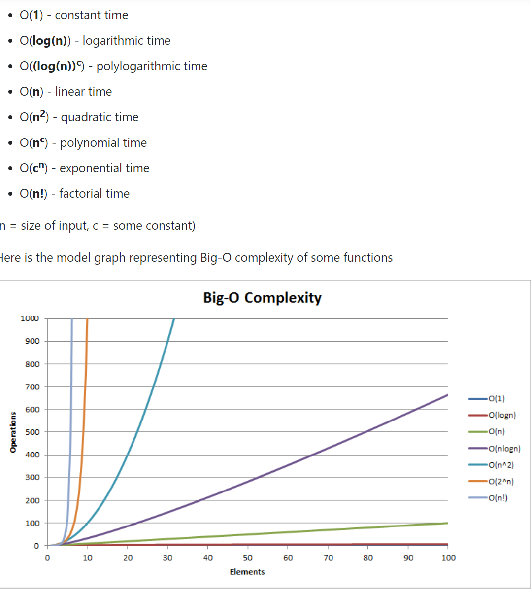
Computational Complexity (i.e. NP Hardness) for Decision Problems Decision Problem = Computational problem with a Yes-No answer
Complexity Type | Description | Solvable in polynomial time | Difficulty Level (Least to most)
P | Can be solved in polynomial time i.e. reasonable run time Time to solve is proportional to the size of the dataset n^{c} where n=size of dataset. (As opposed to exponential c^{n}) Few algorithms are guaranteed to converge to optimality in this time | Yes | 1
NP (Non-deterministic polynomial time) | Many real-world problems | Yes or No | 2
NP-Complete | Both NP and NP-hard | Unknown | 3
NP Hard | Set of problems at least as hard as the hardest | Unknown | 4

Slide 28
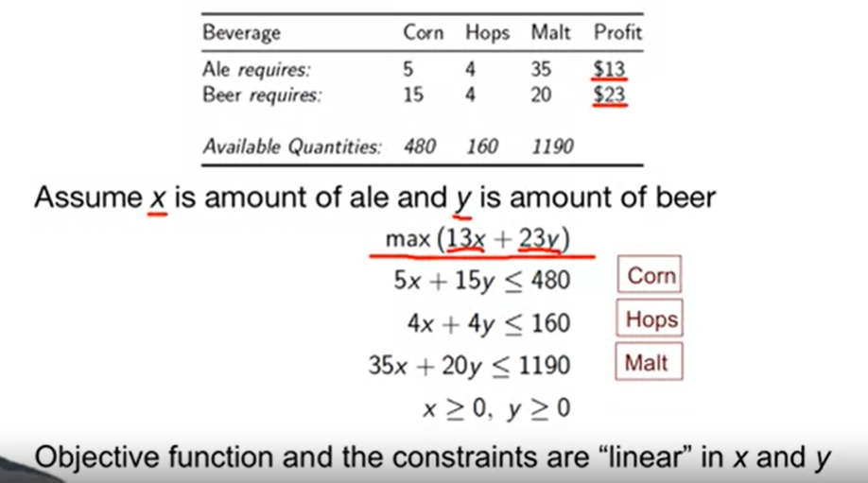
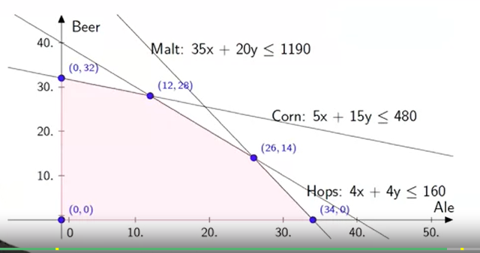
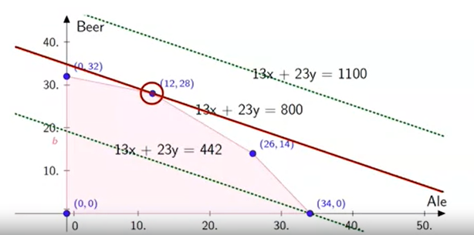
Linear Programming problem – where aim is to max profit
Solution
Red line
Lower dashed line → suboptimal as underutilises resources so does not max profit
Upper dashed line → not within feasible region

Slide 29
OR-Tools
Has two interfaces:
MPSolver (for linear programming) i.e. $ from ortools.linear_solver import pywraplp
CP-SAT Solver (for constraint programming) i.e. $ from ortools.sat.python import cp_model
Solution | Problem Type | Solution Type
CP-SAT Solver | - Problem expressed as constraints (i.e. does not need objective function) - | Feasible solution sets
Linear (LP) | Linear objective function & linear inequalities as constraints Includes GLOP optimisers | Optimal value Decision variables can be float
Mixed Integer (MIP) | Linear objective function & linear inequalities as constraints Includes SCIP optimisers | Decision variables can be integer only

Slide 30
OR-Tools Pros & Cons
Pros | Cons
Hosted by google | Extremely steep learning curve – doesn’t feel overly intuitive at times and dissimilar to python Hard to know what you can and cannot do with variables and what functions are available Few examples available online Limited stack overflow contributions Overall dependent on contributions of Laurent Perron in community questions etc.

Slide 31
Forecasting
Newsvendor problem
Need to order products that customer wants
i.e need to forecast demand
Use past demand to forecast future demand
Objective function is to maximise profits/sales/revenue
Point forecasts often wrong
Forecasts should have distributional information
I.E. confidence interval
Mean and standard deviation
Accuracy of forecasts decreases the further into the future you go
To create forecasting models can either use:
Time series models
Naïve method
Utilises patterns such as trends + cycles + seasonality whilst accounting for randomness
Very very simple methods include just using the previous target to predict the future target. Moving average + exponential smoothing methods can be suitable where stationary time series (lack of seasonality etc.)
a) Moving averages – arithmetic average of the n most recent observations. Experiment with different n to see which performs best
Issues include
Lags behind a trend e.g. seasonal trends (will use autumn observations to predict winter observations) .E.G When decreasing trend, will forecast above the trend. When increasing trend, will forecast above the trned.
Not a casual model
b) Exponential Smoothing
Placing higher weight on most recent predictions
Weights should be small to ensure stable forecasts
Regression
Casual models
Demand is modelled as a theoretical function of n root causes
Causal models are very complex and require advanced tools & all the data & lots of domain expertise
Evaluating forecasting models
Mean absolute deviation
Mean squared error
MAPE (Mean average percentage error)

Slide 32
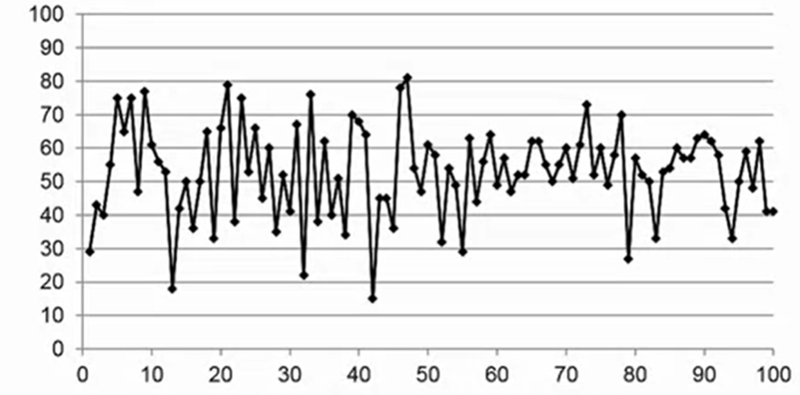
Forecasting cont.
Stationary trend
i.e. steady response variable with obvious noise/random fluctuations
Considerations
How to forecast for brand new products?

Slide 33
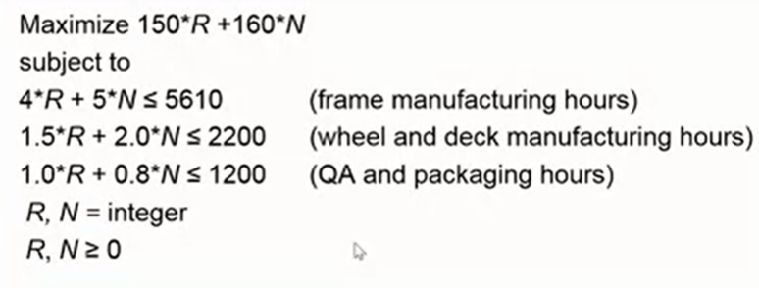
Excel Solver – an excel add-in within data tab
N.B. Can use in google sheets & mac equivalent
Chris recommends using this initially to better understand integer programming and do PoC stuff before converting to a formulation in pulp or whatever python package you may use
Figure out how to turn algebra into decision function, decision variables, constraints for excel
Using PE example:
Decision variables = Discount levels (number of decision variables is equal to number of accounts)
Objective function value = SUM(profit)
Constraints (including hidden conditions e.g. decision variable must be an integer, or values must be non-negative)
Optimisation model MUST have one objective to be min/max, but can have many decision variables and constraints
Might have multiple KPIs you want to keep track of and that could be your objective. So just choose one, and could use the other KPIs as constraints e.g. Profit as Objective and cost / sales as constraints
When uncertainty high, optimisation can become very complex
Need to convert our problem into an algebraic formulation
Use Excel Solver to optimise our model
Linear Models
Such as the example screenshotted is eassy to optimise
Non-linear models
Non-linear expression of decision variables are harder to optimise, especially as the number of variables + constraints grows
Objectives such as these are non-linear: R*N, R², N/(R+N)

Slide 34
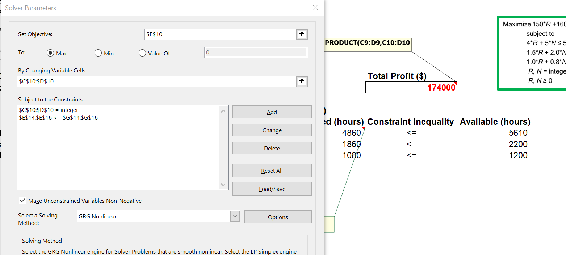
Adds constraint that n_units must be a positive integer
And that each n_hours should be below the pre-specified amount

Slide 35
Solver
Has various solving methods
GRG NonLinear
For lonear and non-linear problems
General method
Hence why default
But cannot guarantee
Depends on initial trial value i.e stochastic – so recommend trialling multiple times with different initial trial values
Simplex LP
If model is linear
Evolutionary
Feasible solution = choice of decision variables that satisfies all constraints (though may not necessarily be the optimum)
Optimal solution = best feasible solution i.e. that satisfied all constraints

Slide 36
Solver Limitations
Useful for learning optimisation but for problems of practical size where ‘000s of decision variables + constraints, will need commercial alternative

Slide 37
Examples of optimisation in industry
Chevron
Determines for each of its 7 refineries, which raw material will be most profitable
A linear program with distributive recursion mathematics
Zara
model to incorporate the link between stock levels and demand to select store replenishment quantities
increased sales by 3–4 percent due to more stock available where demanded

Slide 38
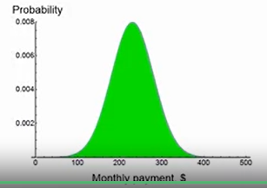
Dealing with uncertainty
Sometimes variables are unknown e.g. sales/demand
Need to model random variables using scenarios i.e. simulations so that we have an expected value (mean) and risk measures (s.d)
If we produce 50 units, we cannot know what demand will be until it has happened so could be 40, 50 or 60 Depending on which it is, we will receive one of three profit (objective function) values
In high uncertainty need to learn the distribution of our KPI (profit/cost/resource utilisation etc.)
How do you pick the distribution??
E.G. How much will I pay on next month’s mobile data plan?
Depends on data usage. For every GB over I must pay £10
Cannot therefore predict bill until know monthly usage
So, we use time series model to forecast monthly usage based on previous usage
Most time series models spit out a predicted mean (23GB) and prediction interval (which will be +/- 2 standard errors depending on the confidence interval used) of 13GB to 33GB (given s.e = 5GB)
Using this, we plot her monthly bill as a normal random variable with mean = £23GB*£10 = £230 and s.d = £50
N.B. This assumes E(V) is a normal random variable i.e. normal distribution

Slide 39
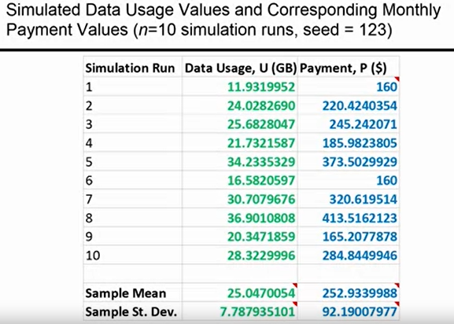
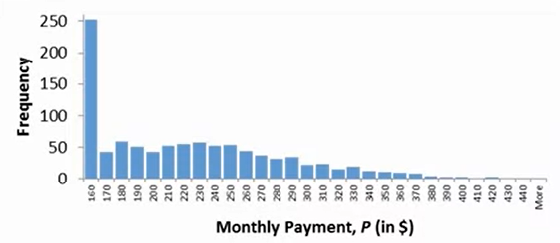
Simulations provide us with reward (expected value) and risk (s.d) measures
E.G. ToolPak add-in for excel can do simple examples but might need commercial packages to fit data to a wider range of distributions (beyond just normally distributed)
Data → Data Analysis → Random Number Generation (can then choose n_simulations/starting seed/RV distribution )
Define n_simulations and your seed
More simulations result in mean approaching the true value & lower s.d. but at the expense of higher compute
Determine probability distribution from which to sample from (i.e. know the mean,s.d, whether it is normal/uniform etc.), in order to produce a random variable for each run
Uses a probability distribution of the input random variable (e.g. monthly usage) to create an output random variable (e.g. monthly payments)
Given our random input variable, we generate a value for each simulation. Plugging this value in should give us an objective function value e.g. monthly payment.
We repeat for all simulation runs
Can then simply take mean of outputs and STDEV of output values to get our reward (expected value) and risk (uncertainty) measures
Use histograms to visualise simulation and understand the distribution of future outcomes (note that distribution of output will not necessarily be distribution of input as per our example)
Histogram of simulated output values
i.e. output distribution when using normally distributed input RV (data usage)

Slide 40
Examples
Intel
Used forecasting, monte carlo simulation and stochastic programming for determining the number of capital investment options to buy and exercise. Imagine this involves predicting demand for a product, then raw materials needed for this etc.
Sensitivty analysis built into it

Slide 41
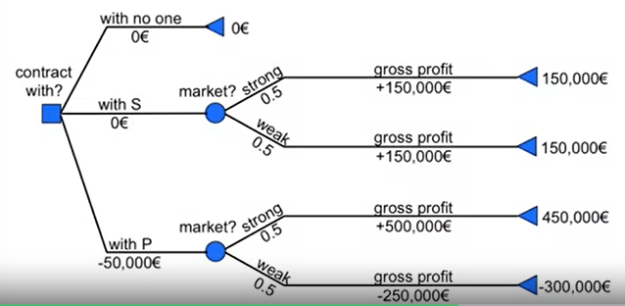
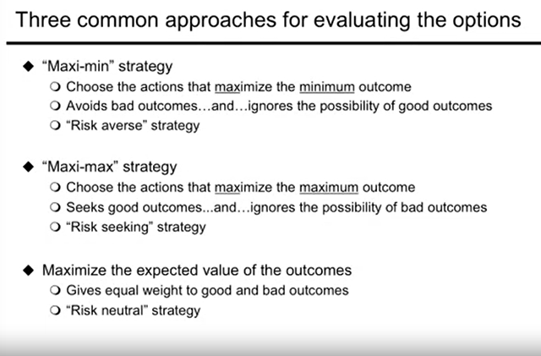
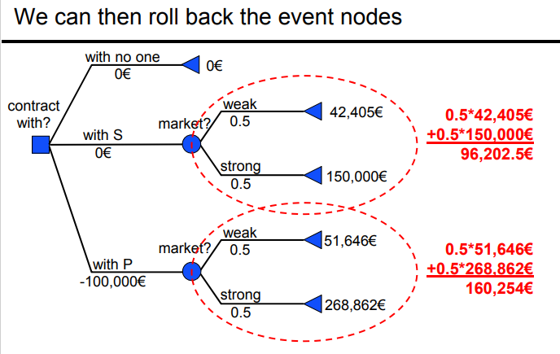
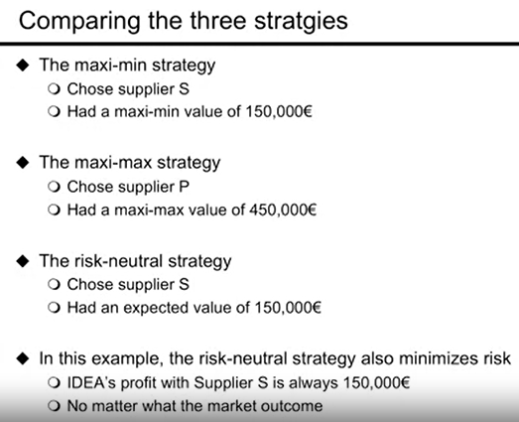
Combining decision trees with simulations to make decisions under high uncertainty
Need the distribution of outcomes under each decision to apply this or a decision tree like below
- Useful to use decision trees when evaluating decisions!
- Assume we have the probabilities of different events that make up the tree splits
We derive the outcomes (expected value at the end of each leaf node)by using our optimisation (solver) and simulation approach. So there might be a 50% probability of strong market, but what does that mean for demand, Q. Could be anywhere within range of 8K-12K sales. Given a uniform distribution we simulate from this distribution and achieve our event outcome that maximises profit
Can then traverse down each branch until we get to the terminal node, multiplying our probabilities by our expected outcome value to allow us to evaluate the best option for our your risk appetite (neutral/loving/averse)
N.B. May need to apply cash discounting if time element over each tree depth
In effect we are answering two questions:
Which Q will maximise profit for each scenario (i.e. under a weak economy vs strong or using supplier A vs supplier B)
Given these expected values from each scenario, which choice to make (and this is where risk appetitre must be factored in)

Slide 42
Using simulations to provide expected values under high uncertainty
Simulations provide a range of answers rather than a single deterministic answer, and so as part of this have a confidence interval attached
A simplified example might be that there is only one outcome for each scenario e.g.
if strong economy (50% chance), profit = Y_{strong} (e.g. £200k)
If weak economy (50% chance), profit = Y_{weak} (e.g. £5k)
But in reality, even if we know economy is set to be strong, we do not know the extent of this so profit falls within a random distribution of values
For strong: 6K-14K units sold
For weak: 2K-8K units sold
Calculating the value for this is tricky using a decision tree, so use simulations to get an expected (avg) value as our profit estimation (i.e. terminal node outcome value)

Slide 43
Steps to solve their problem i.e. choose which company as supplier to maximise profit given our demand forecasts under different conditions Many suppliers to choose from – which one to choose and how many units, Q, to order given different costs etc.
Identify the problems and its decisions/constraints/objective
Formulate the optimisation problem as a mathematical model
Develop a spreadsheet model (I.e. use toy data in excel to start analysis or all data if simple enough)
Predictive model fitted (e.g. time series to predict demand) – point estimate and prediction interval (s.e)
Ran the simulation using randomly sampled values from our predictive model (profit using different demand estimates from our RV distribution from our fitted model), potentially for each supplier
Given the expected value (avg) across all simulations for each supplier, we performed the optimisation (Excel solver) to find the expected (avg) profit maximising quantity, Q, given our simulation samples
-i.e. what quantity do we need to supply under each scenario to maximise profit
If multiple suppliers, plug these into a decision tree and use your evaluation framework to make your decision (i.e. is your risk preference maximin, minmax etc. – will determine your choice)

Slide 44
????
Can do sensitivity analysis
i.e. find “break-even” probabilities (where we become indifferent between choosing decision A or decision B)
Probability of a strong market needed so that P maximises expected value

Slide 45
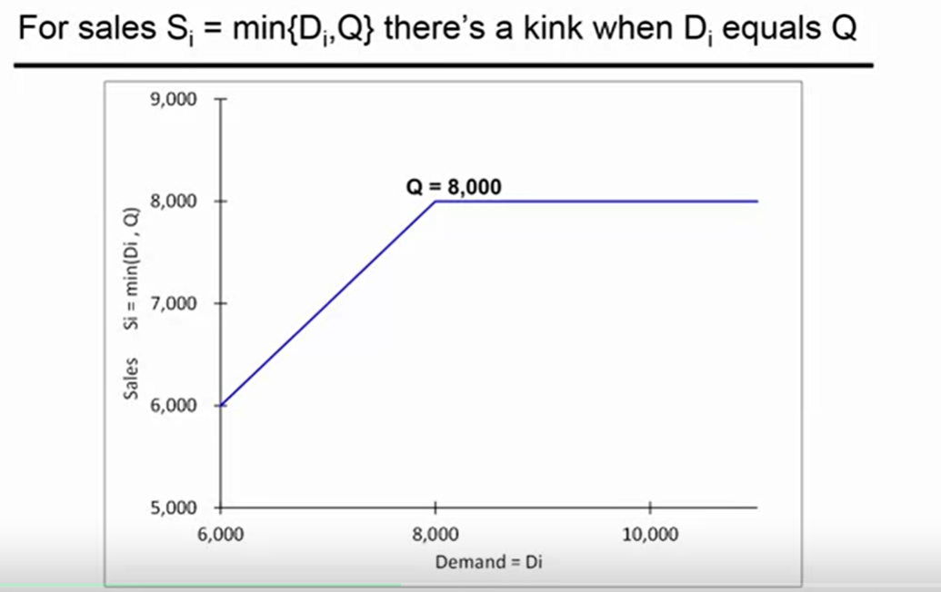
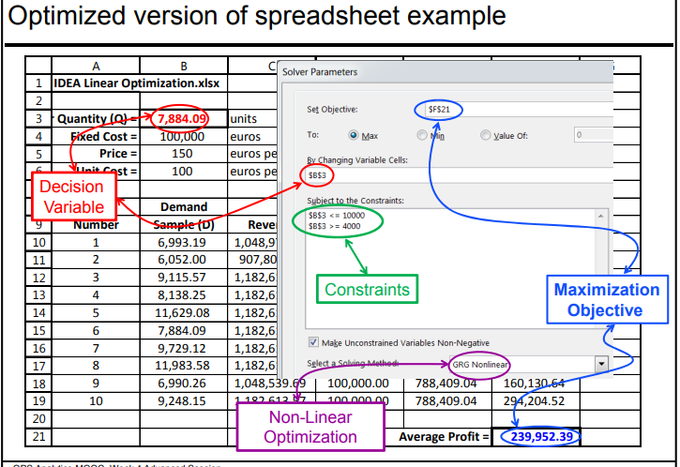
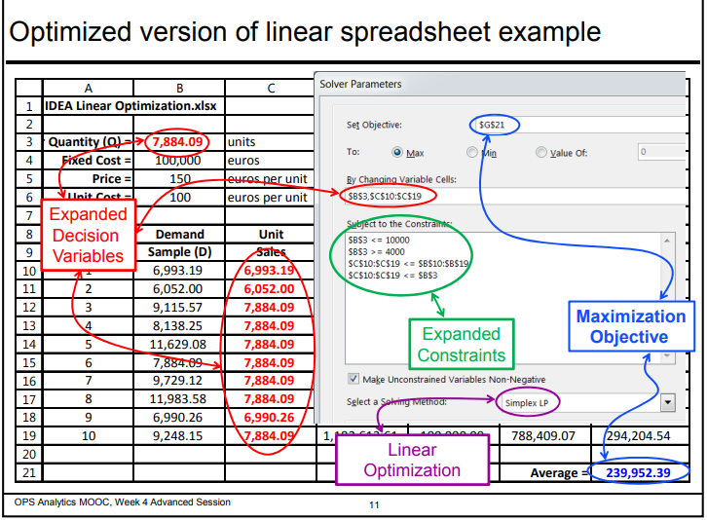
Transforming a non-linear optimisation problem (NLP) into a linear (LP) one
What does non-linear mean?
Where the constraint or objective is non-linear
Why do we need to transform them?
Linear programs are so much easier to solve than nonlinear programs
There is a chance that excel solver cannot solve it if non-linear
Objective function value = max revenue = 150 * min(D,Q)
Graph shows Min(D_{i},Q) and indicates a kink exists i.e. non-linear
Where non-linear cannot use default GRG Nonlinear solving method
Transforming your problem into a linear one can be an “art” form
Solution for this problem?
Add extra decision variables + extra constraints
S_{i} – an additional decision variable for each simulation sample
S_{i}<D_{i} so sales are never more than demand
S_{i} < Q so sales are never more than the order quantity
Means that when solver maximises the expected (avg) profits, each S_{i} is maximised
Tricks:
transform constraints or objectives involving absolute values into linear constraints and objectives
transform maximizing the min of linear functions or minimizing the max of linear functions
transform ratio constraints into linear constraints
Non-linear problem …
…. transformed to a linear problem

Slide 46
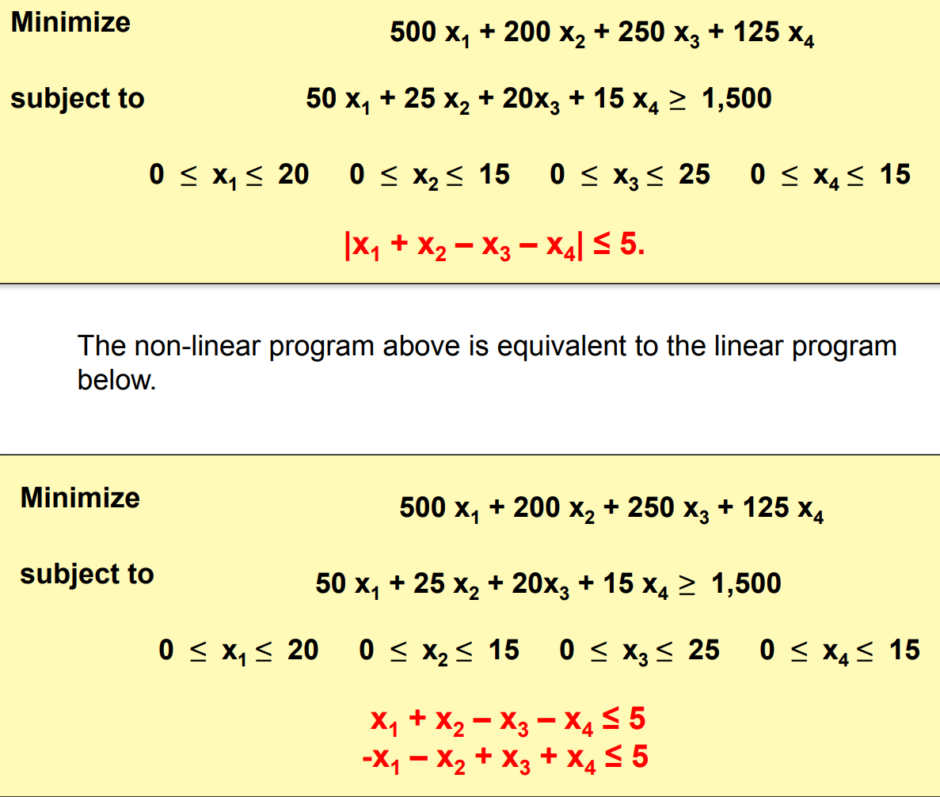
Transforming linear to non-linear continued…

Slide 47
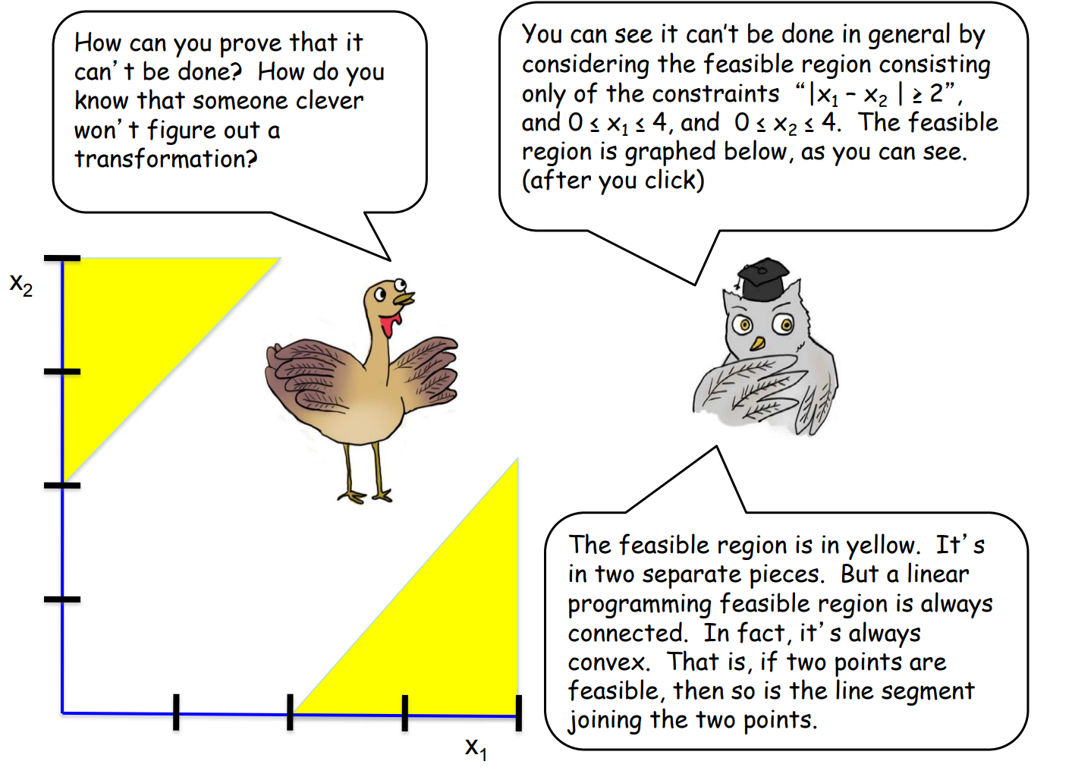
Sometimes you won’t be able to transform it into a linear problem

Slide 48
Constraints on risk i.e. ensuring the solution fits their risk tolerance
Can also add constraints on risk (i.e. extent of standard deviation)
When using simulation, we have an expected value (mean) and a risk value (stdev)
Might want to limit that stdev so that lower chance of getting negative profit
E.G. Mean Profit = £500, stdev = £300 → seems a bit risky with 95% chance of profit being between -£100 and £1100 vs….
Mean profit = £400, stdev = £100 → between £200 and £600
N.B. standard deviation term is not linear, is quadratic. However is a well-behaved type of non-linear function

Slide 49
What about uncertainty in binary classification?
How do we get a prediction interval?
For each customer, how do you get their save probability distribution ?

Slide 50
Summary
Monte Carlo is a simulation technique for modelling high uncertainty
Use distribution fitting on historical data to get a probability distribution from which to sample from
Can then run n simulations using this probability distribution function for each of your uncertain variables, which in turn can generate a predicted objective function value
Managers want to analyse risk so they can understand the distribution of outcomes and associated confidence interval for these
Consider correlation when building a simulation model – some uncertain variables might well be correlated e.g. ticket demand and number of no-shows

Slide 51
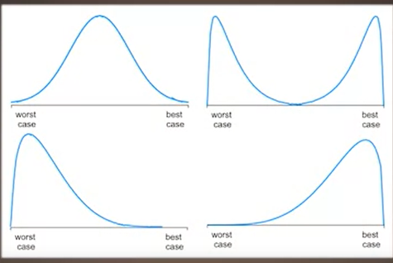
If uncertainty present in system then there is an element of risk to be considered in the decision making process
Types of uncertainty:
Know all outcomes + know probability of each outcome
e.g. dice roll
May not know outcomes and/or know probability of each
e.g. profit – we know Profit = (Demand*Price)-Cost
Price and cost are known by demand is not
Variability in demand introduces randomness
Will need to rely upon historical patterns to assess risk
Expected values (avg) good but do not include risk (s.d/distributions)
Risk analysis required
Most simplest form of this is best case vs worst case analysis
Limitation of this is that it tells us nothing about the distribution of outcomes.
Could have any distribution with very different risk profiles
But how to get this distribution of values
USE MONTE CARLO SIMULATION !!
Limitation of best-worst case scenario to evaluate risk

Slide 52
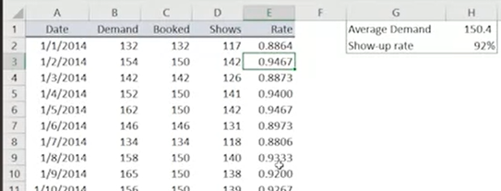
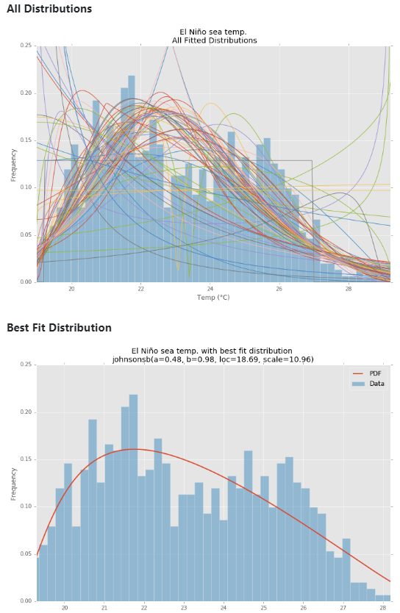
Monte Carlo Simulation
Using empirical data to estimate our distributions for highly uncertain variables
A predictive analytics tool for modelling uncertainty
clearer picture than a deterministic forecast
Definition - the process of generating random values for uncertain inputs in a model and computing the output variables of interest
can be used to simulate risk/uncertainty (it models the probability of different outcomes in a process that cant otherwise be easily predicted due to the intervention of RVs) which in turn may impact the chosen decision variable (i.e. units supplied / offers given)
Uses past data to predict a range of future outcomes based on a choice of action e.g. to estimate first month’s sales of a new product, you can give the Monte Carlo simulation your historical sales data and it will estimate different sales values based on factors such as general market conditions, product price, and advertising budget
Useful where too many variables affecting the outcome, then it can simulate them and find the optimal based on the values
Whereas we could use what-if analysis that involves plugging in possible input values, this is:
A biased sample of input values
Hard to do many what-ifs
Monte Carlo instead randomly generates a number from a distribution – thus requires assumptions about the behaviour of uncertain value cells e.g. uniform / normal etc.
This is based on using historical data (i.e. empirical distribution) / domain knowledge etc.
E.G. use a density plot (proportional histogram) of demand over past 365 days to conclude demand follows a poisson distribution
DISTRIBUTION FITTING = Useful approach to convert historical data into probability distribution functions (which can then be used in simulations)
You fit your data to a probability distribution function
Use distribution tests i.e. hypothesis tests that determine whether drawn from a population that follows a specific distribution (do this for range of possible distributions and choose one that has lowest p-value??)
OR fit to a QQ-plot and see which fits closest to line
OR directly use pytjon package that fits data to some function e.g. Fitter library (from fitter import Fitter, get_common_distributions, get_distributions) OR scipy where can fit to >90 distributions and calc SSE for each and choose one that minimises it

Slide 53
Issues with Monte Carlo
highly dependent on input values and distribution. If mistakes are made when electing the input and probability distribution, it can lead to inaccurate results
Potentially excessive computational power to perform MC experiments - can take hours or days to complete on a single computer.

Slide 54
Aviation industry – use of monte carlo simulations to decide their policy on how many seats to overbook
Overbook flights as know some passengers do not show up, allows them to max profit
But risk that everyone shows up and some cannot get on (involving huge cost to airline as must compensate), so need model to assess risk and extent to which they should overbook for certain routes
Uncertain variables
1. Ticket demand (i.e. tickets sold for aeroplane)
Use historical data know it is from poisson distribution – avg demand = 150 passengers for this route
2. Show-up rate (i.e. % of ticketed passengers that show up at gate)
Use historical data and plot using binomial distribution – 92%
Constraints
n_seats on plane
Perform n_simulations
For each run, will extract RV from demand and show up rate distributions
Gives us the n_customers_bumped which is then used to derive net revenue KPI
N.B what to do if correlated Ivs???? Where the random variable from one is somewhat dependent on the other?? Do you just reduce to one??
Using the expected n_customers_bumped across all simulations, can say something that there is a 95% chance that bumped passengers is <= 2 when overbooked tickets = 9 → based on airline’s risk appetite, will say if this is okay. If risk averse, might want 99% chance so overbooked tickets =7 instead
Will also have associated profit for each of these decisions ….

Slide 55
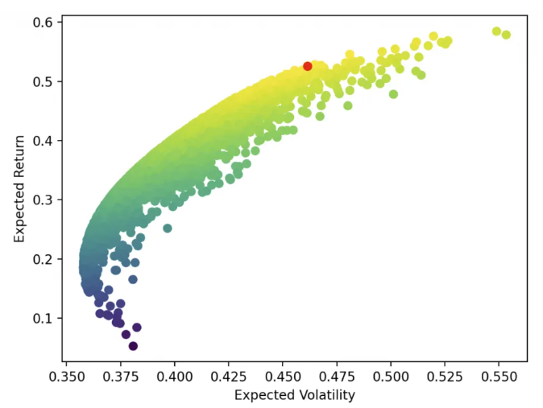
Monte Carlo use case – Portfolio Optimisation
Optimal portfolio management
Wanted to produce a portfolio that was as robust to all the possible outcomes as is possible
Simulated ~20,000 potential futures
Simulation based on bootstrapped historical data + novel simulated data
Historical data incorporates important aspects of asset return movements e.g. autocorrelation / skew /fat tails
Novel – can generate other potential outcomes like market crashes that may not be available in recent historic data
Bootstrapping = take random chunks (contiguous) of historical data and reorder it (robust to risk that is solely optimised for the past)
E.G.2 Get historic stock prices. We can then calculate daily returns using this. But these are dependent on various variables e.g. gdp_growth. For each variable we know it will fall within certain ranges (-2 to 2% growth) so we sample from this for each iteration and plug into our formula to get expected returns or more specifically our sharpe ratio. We run n_simulations, storing the RV each time and the resultant outputs. Can then plot this to get our efficient frontier
Efficient frontier

Slide 56
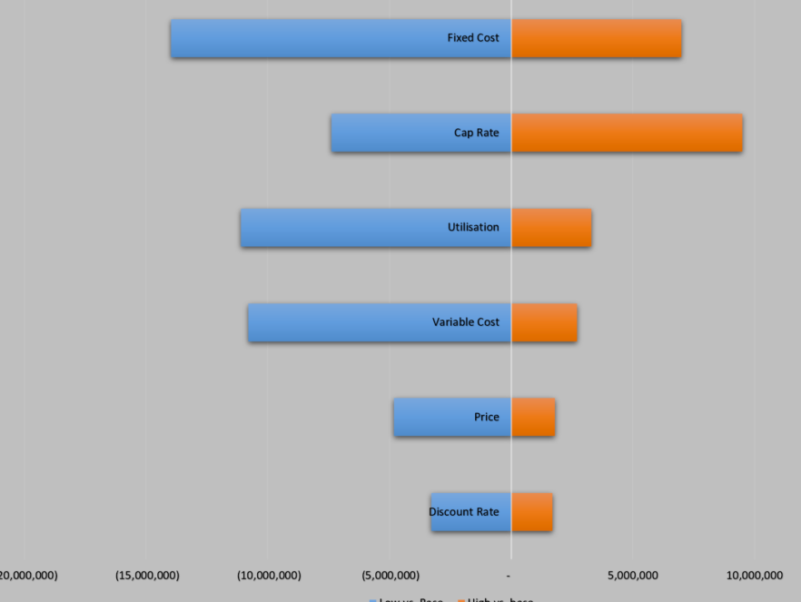
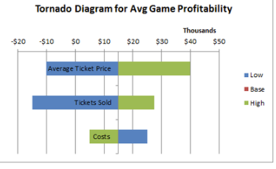
Tornado charts are used for Sensitivity Analysis
Get objective value estimates for what the low,base and high outcomes would be of each decision variable
Believe it is based on the correlation between inputs & output
One of the easiest ways to increase the effectiveness of your optimization is to remove decision variables that require a lot of effort to evaluate and analyze, but that do not affect the objective very much → hence we use a tornado chart to visualise how sensitive our objective is to each decision variable
Charts shows how sensitive the objective is to each decision variable as they change over their allowed ranges (ordered by impact magnitude on the objective)
If effect is significantly smaller than those at the top, you can probably eliminate them as variables and just let them assume a constant value OR can just put less effort into ensuring they are precise estimates

Slide 57
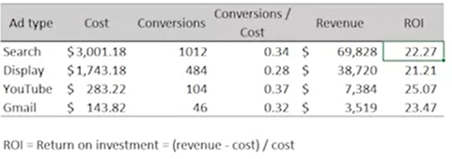
Optimisation in digital marketing
Limited advertising budgets
How best to allocate budget across different channels
Gmail ads
Search ads
Display ads
Track conversions, not clicks
Want to get at least 1500 conversions (benchmark)
Objective function value = max net revenue

Slide 58
Using average values vs simulation to predict your objective function value
Will not lead to the same answer
If use avg value for uncertain decision variable, expect avg value for uncertain output → THS IS NOT NECESSARILY TRUE → Called the “flaw of averages”
Flaw of averages = when average value is used to represent an uncertain future quantity

Slide 59
Chance constraints
Can be used to add uncertainty to models
Instead of insisting that a constraint is satisfied 100% of the time, we allow it to be satisfied a fraction of the times.
Allows for more robust solutions. This is in contrast to solutions that cover all possible scenarios which can be expensive due to resources required to find this optimal
E.G. number of workers needed at each shift is x. Sometimes this is not met, so may need to provide more workers . Does not account for the magnitude of the constraint violation, just the number of times i.e. shifts where fewer workers turned up than needed. Need conditional value at risk for this
Simulation is most common mechanism for developing a model with VaR constraints
Will decide how conservative you want VaR to be e.g. % of times you want enough staff – 90%. The higher this is, the higher the number of workers youll employ on each shift which may decrease profit…..so trade-off based on risk appetite

Slide 60
Optimisation in Neural Networks
Optimisation in neural nets difficult as:
Highly complex and multidimensional loss surfaces
Need for generalisation
Little theoretical foundation in this field
Main optimiser in neural net is the 1st order gradient descent optimiser (determines time of convergence and impacts performance)
IN NN CANNOT use second order methods as are very slow – and are attracted to saddle points which are numerous in neural network space
SGD
Good at escaping local minima (i.e. regions of high gradient)
Good at generalisation
At each iteration sees a slightly different loss surface, so can escape local minima
ADAM
Aims to speed up SGD
Adaptive learning rates - Has different learning rates for each parameter
Depends on slope of each

Slide 61
Uses differential evolution algorithm - a stochastic optimisation algorithm to find the global max of non-linear functions s.t. any constraints (because relatively simple problem type i.e. non hessian etc) to determine optimal boundary setting of groups to max EBIT

